Slide 1

SEIS 763 Machine Learning
Team 4
Wess Kilker
Tianyu Lei
Jason Xiao
Jessica Zastoupil
Notes:
LTY

Slide 2

Data Set
Deciding on a data set
True dependent variable
More quantitative variables
Clean data
Bicycles are available for rent in many large cities. It is important to know how the weather can affect bike rentals so that the city has enough bikes available to meet the rental demand
The dataset contains weather information, the number of bikes rented per hour, and date information, detailed to the right.
Numeric Columns
Date – Date, dd/mm/yyyy
Hour - int, Hour of the day
Temperature - Temperature in Degrees Celsius
Humidity - % of Humidity
Wind Speed - Wind Speed in meters/second
Visibility - Visibility in 10m range
Dew Point Temperature - Degrees Celsius
Solar Radiation - Solar Radiation in millijoule/square meter
Rainfall - Rainfall in mm
Snowfall - Snowfall in cm
Categorical Columns
Seasons - Winter, Spring, Summer & Autumn
Holiday - Holiday/No Holiday for Public Holidays from the South Korean Public Holidays List
Functioning Day - Yes/No - Whether the rental system was functioning that day or not.
Dependent Variable
Rented Bike Count - Number of Bikes Rented in the Hour of the Day with Specified parameters.
Notes:
LTY

Slide 3
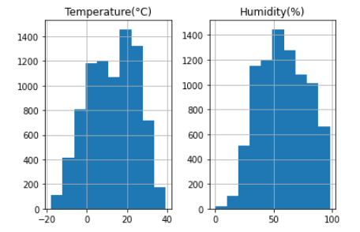
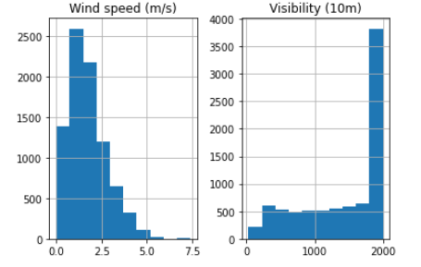
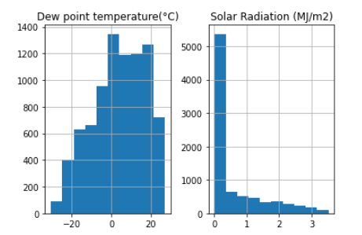
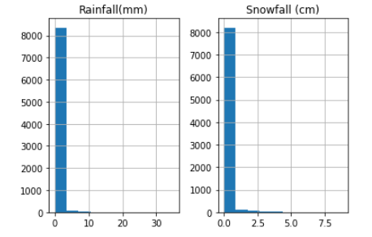
Data Exploration
Notes:
WK

Slide 4
Data Preparation
Import unaltered data (‘Latin1’ Encoding)
Filtering data
Removed non-functioning days = False
Converting date to DayOfWeek (0 - 6)
Removed columns Date and Nonfunctioning days
Moved dependent variable (Rented Bike Count) to the end
Split Data Into X and Y
One-Hot Encode Seasons and Holiday
Removed two extra features
Normalize Data using StandardScaler
Notes:
JZ
Load error:
UnicodeDecodeError: 'utf-8' codec can't decode byte 0xb0 in position 12: invalid start byte
You have to use the encoding as latin1 to read this file as there are some special character in this file, use the below code snippet to read the file,
"encoding ='latin1' " mean means that dev tools are sourcing the files as latin1 instead of the UTF-8 files that they are. This happens irrespective of the Encoding: UTF-8.

Slide 5
Feature Selection and Models
Feature Sets:
All Features
Backward Elimination
PCA
Kernel PCA
Models:
Linear Regression
Polynomial Regression
kNN Regression
Tree Forest Regression
Notes:
JX

Slide 6
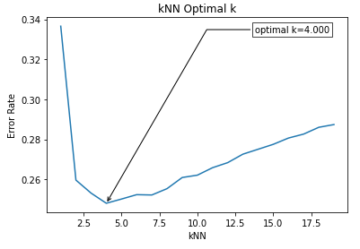
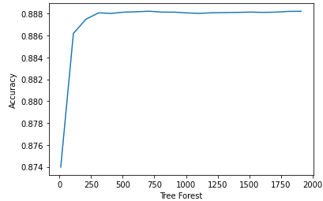
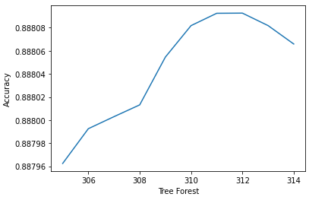
Hyperparameter Selection
 | Linear Regression | Polynomial Regression Degrees: 2 | Tree Forest Estimators: 311 | kNN Regression Neighbors: 4
Accuracy | 0.5370 | 0.6811 | 0.8833 | 0.7520
Cross Val - Mean | 0.5398 | 0.6963 | 0.8881 | 0.7622
Cross Val - Std Dev | 0.0275 | 0.0225 | 0.0137 | 0.0203
MSE | 1874.214 | 1367.0846 | 472.4546 | 1004.0121
RMSE | 0.4329 | 0.3697 | 0.2174 | 0.3169
Notes:
WK

Slide 7
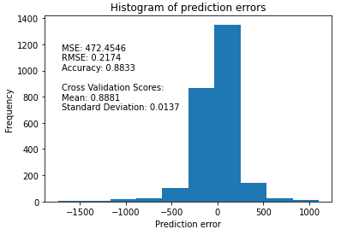
All Features
Best fit: Tree Forest Regression
 | Linear Regression | Polynomial Regression Degrees: 2 | Tree Forest Estimators: 311 | kNN Regression Neighbors: 4
Accuracy | 0.5370 | 0.6811 | 0.8833 | 0.7520
Cross Val - Mean | 0.5398 | 0.6963 | 0.8881 | 0.7622
Cross Val - Std Dev | 0.0275 | 0.0225 | 0.0137 | 0.0203
MSE | 1874.214 | 1367.0846 | 472.4546 | 1004.0121
RMSE | 0.4329 | 0.3697 | 0.2174 | 0.3169
Notes:
WK
R^2 Score
R-squared evaluates the scatter of the data points around the fitted regression line. It is also called the coefficient of determination, or the coefficient of multiple determination for multiple regression. For the same data set, higher R-squared values represent smaller differences between the observed data and the fitted values.

Slide 8
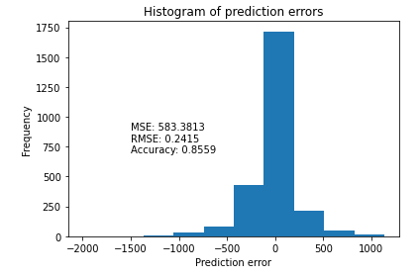
Backwards Elimination
Best fit: Tree Forest Regression
 | kNN Regression | Linear Regression | Polynomial Regression | Tree Forest
Accuracy | 0.8097 | 0.5366 | 0.7793 | 0.8559
Cross Val - Mean | 0.8132 | 0.5380 | 0.7415 | 0.8580
Cross Val - Std Dev | 0.0156 | 0.0264 | 0.0514 | 0.0133
MSE | 770.1050 | 1875.7433 | 893.2027 | 583.3813
RMSE | 0.2775 | 0.4331 | 0.2989 | 0.2415
Notes:
JZ
R^2 Score
R-squared evaluates the scatter of the data points around the fitted regression line. It is also called the coefficient of determination, or the coefficient of multiple determination for multiple regression. For the same data set, higher R-squared values represent smaller differences between the observed data and the fitted values.

Slide 9
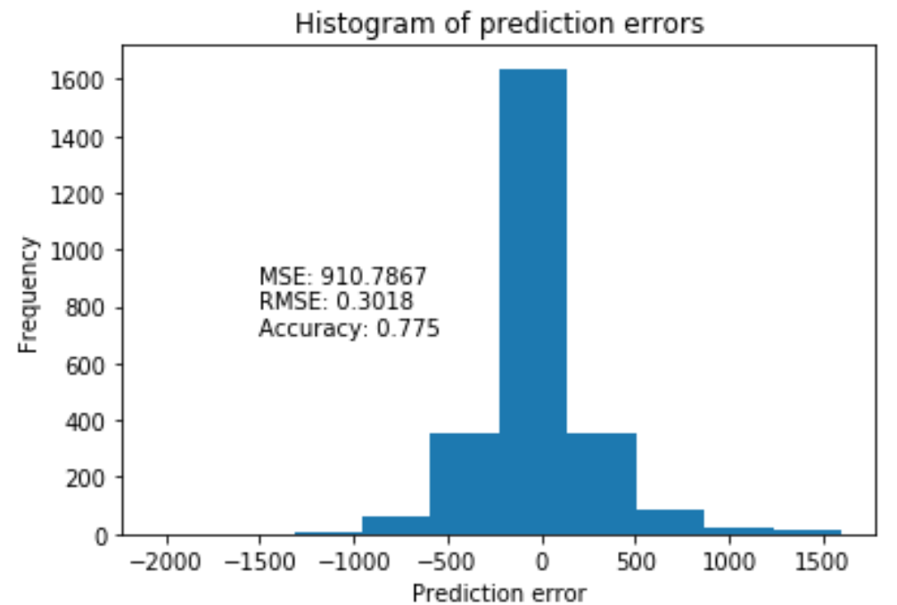
Regression After PCA
Best fit: Tree Forest Regression
 | kNN Regression | Linear Regression | Polynomial Regression | Tree Forest
Accuracy | 0.7520 | 0.5370 | 0.6357 | 0.7750
Cross Val - Mean | 0.7622 | 0.5398 | 0.6424 | 0.7786
Cross Val - Std Dev | 0.0203 | 0.0275 | 0.0565 | 0.0216
MSE | 910.7867 | 1875.214 | 1474.5398 | 910.7867
RMSE | 0.3018 | 0.4329 | 0.384 | 0.3018
Notes:
LTY
R^2 Score
R-squared evaluates the scatter of the data points around the fitted regression line. It is also called the coefficient of determination, or the coefficient of multiple determination for multiple regression. For the same data set, higher R-squared values represent smaller differences between the observed data and the fitted values.

Slide 10
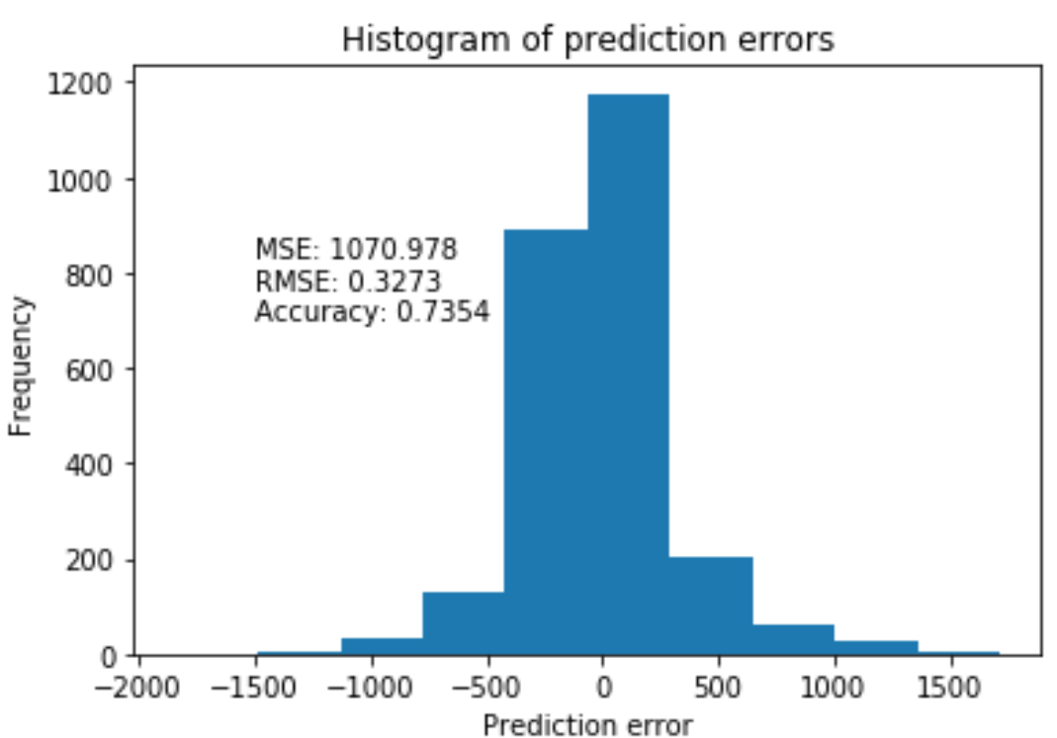
Regression After Kernel PCA
Best fit: Tree Forest Regression
 | kNN Regression | Linear Regression | Polynomial Regression | Tree Forest
Accuracy | 0.7206 | 0.5705 | 0.7013 | 0.7354
Cross Val - Mean | 0.7332 | 0.5911 | 0.6506 | 0.7388
Cross Val - Std Dev | 0.0245 | 0.0285 | 0.1241 | 0.0164
MSE | 1070.978 | 1738.3417 | 1209.0369 | 1070.978
RMSE | 0.3273 | 0.4169 | 0.3477 | 0.3273
Notes:
JX
R^2 Score
R-squared evaluates the scatter of the data points around the fitted regression line. It is also called the coefficient of determination, or the coefficient of multiple determination for multiple regression.
For the same data set, higher R-squared values represent smaller differences between the observed data and the fitted values.

Slide 11
Overall Results and Conclusion
Model | Feature Set | Accuracy | Cross Val - Accuracy Mean | Cross Val - Accuracy StDev | MSE | RMSE
kNN Regression | All Features | 0.7520 | 0.7622 | 0.0203 | 528.9271 | 0.2300
 | Backward Elimination | 0.8097 | 0.8132 | 0.0156 | 770.1050 | 0.2775
 | kPCA | 0.7206 | 0.7332 | 0.0245 | 1070.9780 | 0.3273
 | PCA | 0.7520 | 0.7622 | 0.0203 | 910.7867 | 0.3018
Linear Regression | All Features | 0.5370 | 0.5398 | 0.0275 | 1874.2140 | 0.4329
 | Backward Elimination | 0.5366 | 0.5380 | 0.0264 | 1875.7433 | 0.4331
 | kPCA | 0.5705 | 0.5911 | 0.0285 | 1738.3417 | 0.4169
 | PCA | 0.5370 | 0.5398 | 0.0275 | 1874.2140 | 0.4329
Polynomial Regression | All Features | 0.6811 | 0.6963 | 0.0225 | 1367.0846 | 0.3697
 | Backward Elimination | 0.7793 | 0.7415 | 0.0514 | 893.2027 | 0.2989
 | kPCA | 0.7013 | 0.6506 | 0.1242 | 1209.0369 | 0.3477
 | PCA | 0.6357 | 0.6424 | 0.0565 | 1474.5398 | 0.3840
Tree Forest | All Features | 0.8833 | 0.8881 | 0.0137 | 472.4546 | 0.2174
 | Backward Elimination | 0.8559 | 0.8580 | 0.0133 | 583.3813 | 0.2415
 | kPCA | 0.7354 | 0.7388 | 0.0164 | 1070.9780 | 0.3273
 | PCA | 0.7750 | 0.7786 | 0.0216 | 910.7867 | 0.3018
Notes:
JX + Everyone else
R^2 Score
R-squared evaluates the scatter of the data points around the fitted regression line. It is also called the coefficient of determination, or the coefficient of multiple determination for multiple regression. For the same data set, higher R-squared values represent smaller differences between the observed data and the fitted values.

Slide 12
What we could have done better?
Research and trial other models, feature reductions, or hyperparameters
Alternative collaborative notebooks, i.e., Google Cloud, Azure, or AWS
Parse Date and Hour data differently
Notes:
JZ

